Slide 1
Understanding the Social Impacts of New Tree Planting – a Longitudinal Study
George Murrell, Beth Brockett, Clare Hall, Berglind Karlsdóttir, Elliot Colley
Society & Environment Research Group
(SERG)
IAPS Conference - Barcelona – 05.07.24

Slide 2
Background
Tree planting rates in UK will increase to 30,000 hectares per year by 2025.
Largely driven by net zero and nature restoration targets.
The UK landscape is therefore undergoing significant environmental change.
Environmental/economic impacts relatively well understood, but social impacts are less clear - particularly in relation to new planting and young woodlands.

Slide 3
Research gaps
Two research gaps were identified:
1
Lack of evidence on the social impacts of new planting / young woodland
2
Lack of evidence on how these impacts might change over time

Slide 4
Research objectives
1
Identify and develop connections with woodland sites and communities to
study over time
2
Explore attitudes, motivations, actions, barriers and benefits linked to new
planting and young woodland for diverse communities.
3
Develop and test a proof-of-concept* for longitudinal research to study
how attitudes, motivations, actions, barriers and benefits for communities
local to new planting change over time.
*proof-of-concept refers to establishing through testing whether such longitudinal
research is feasible, what it would contribute, and how it could be achieved

Slide 5
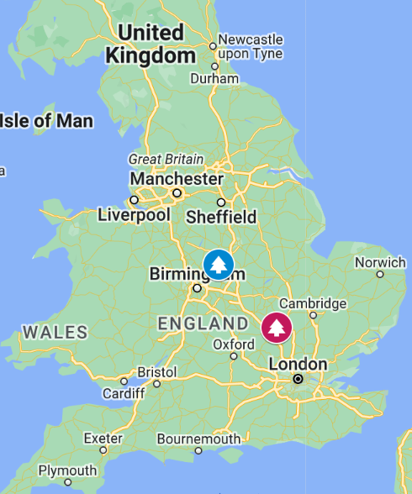
Case study sites
The National Forest
Former coal mining and clay extraction
Aim for 33% of the landscape to be forested
The Forest of Marston Vale
Community forest
Former brickworks and landfill
Aim to increase tree cover in the forest boundary from 3% to 30%

Slide 6
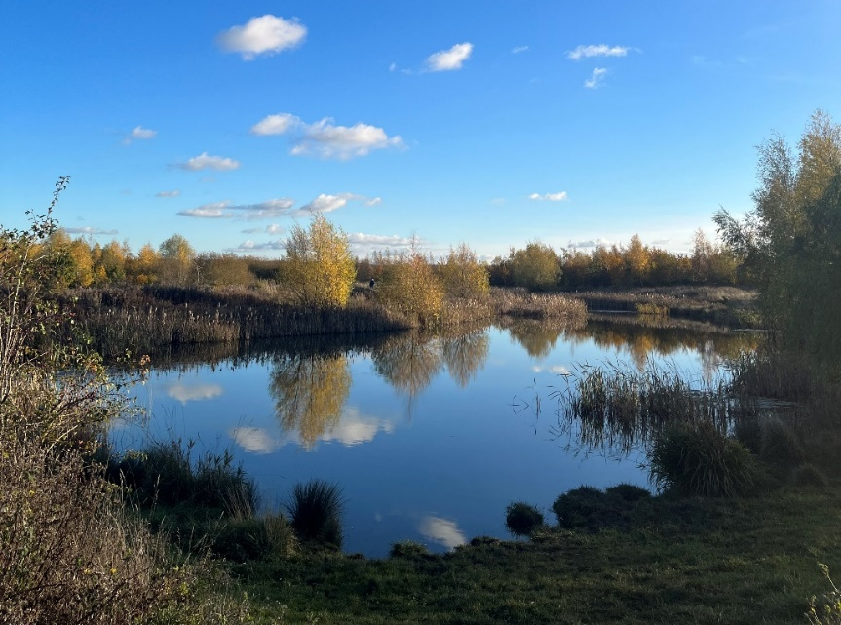
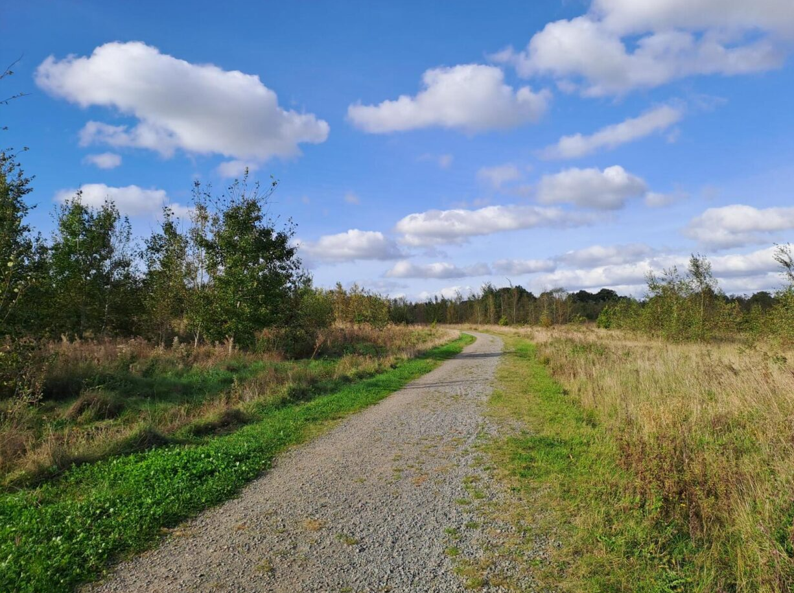
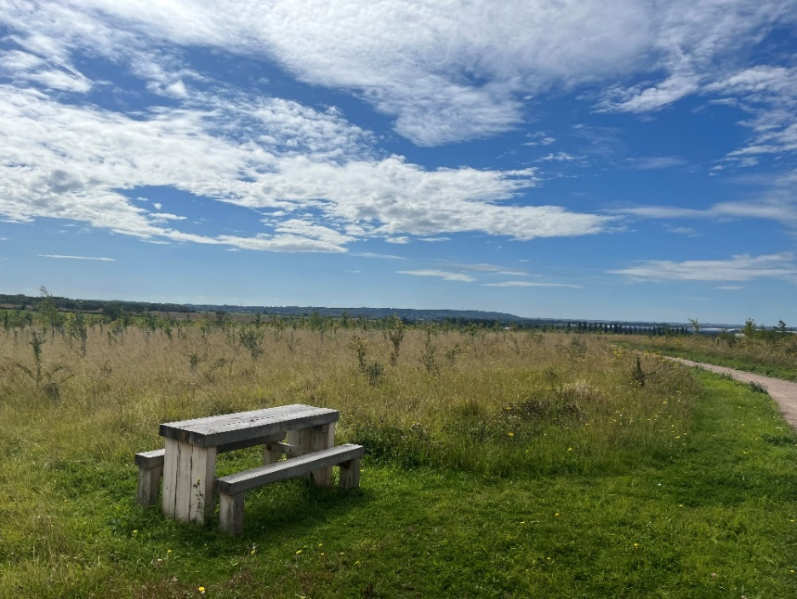
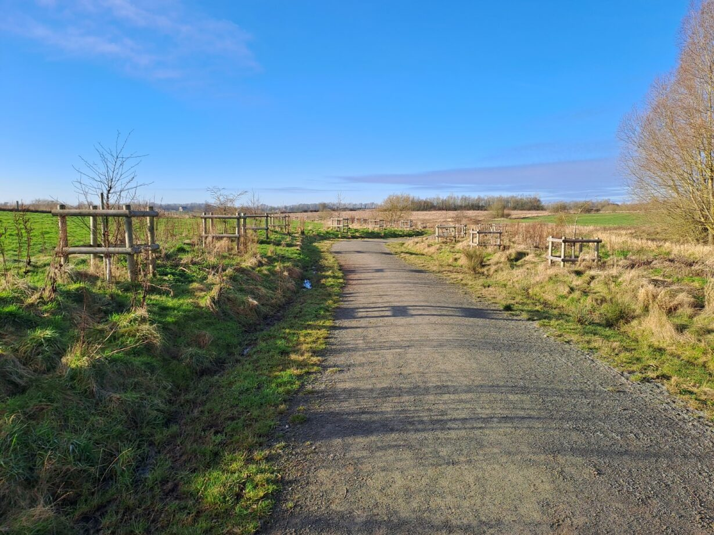
Case study site photos
Rectory Wood, Forest of Marston Vale
Queen Elizabeth Diamond Jubilee Wood, National Forest
Waypost Wood, Forest of Marston Vale
Sence Valley, National Forest

Slide 7
Mixed-Methods Approach
Quantitative approach - sampling at the community level. A cohort of people who live locally to new planting.
Qualitative approach – using a case biography approach to gather in depth data with a small number of participants.

Slide 8
Methods - qualitative
Wave 1
Retrospective lens
Life history approach
Wave 2
Present lens
Walking interviews
Wave 3
Prospective lens
Looking to the future

Slide 9
Qualitative Analysis
Case biography approach:
Focus is on a couple of illustrative ‘cases’ (participants).
Allows detailed exploration of few cases and themes.
Data analysed both cross-sectionally and temporally.

Slide 10
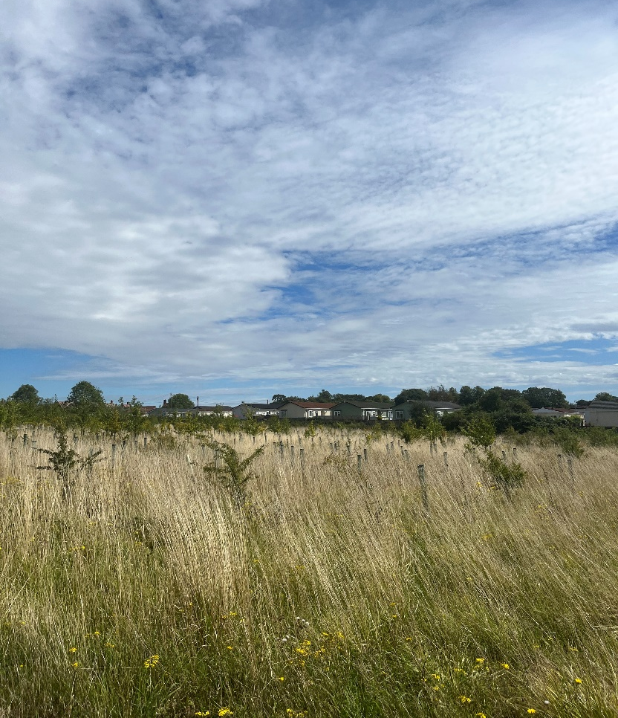
Reflections on methods so far
Qualitative
Research tools
Pen portraits are a really useful tool to aid interviews
Recruitment
Recruiting for a longitudinal study proved difficult
Observing change
Intensive research design means we may not observe much change
But there are other benefits of qualitative longitudinal research
Using retrospective/prospective lenses helped with this
Waypost Wood, Forest of Marston Vale

Slide 11
Thank you for listening! Questions? Contact email: george.murrell@forestresearch.gov.uk
This project is funded by the Department for Environment, Food & Rural Affairs as part of the Nature for Climate Fund.

