Slide 1
New woodland and local communities – understanding the benefits over time
Official title: TWF-16 Mapping the social benefits of woodland creation and expansion – proof of concept for setting up a longitudinal network
Dr Beth Brockett, Berglind Karlsdóttir, Dr Clare Hall, Elliot Colley, George Murrell - Forest Research
Summary of key findings September 2025

Slide 2
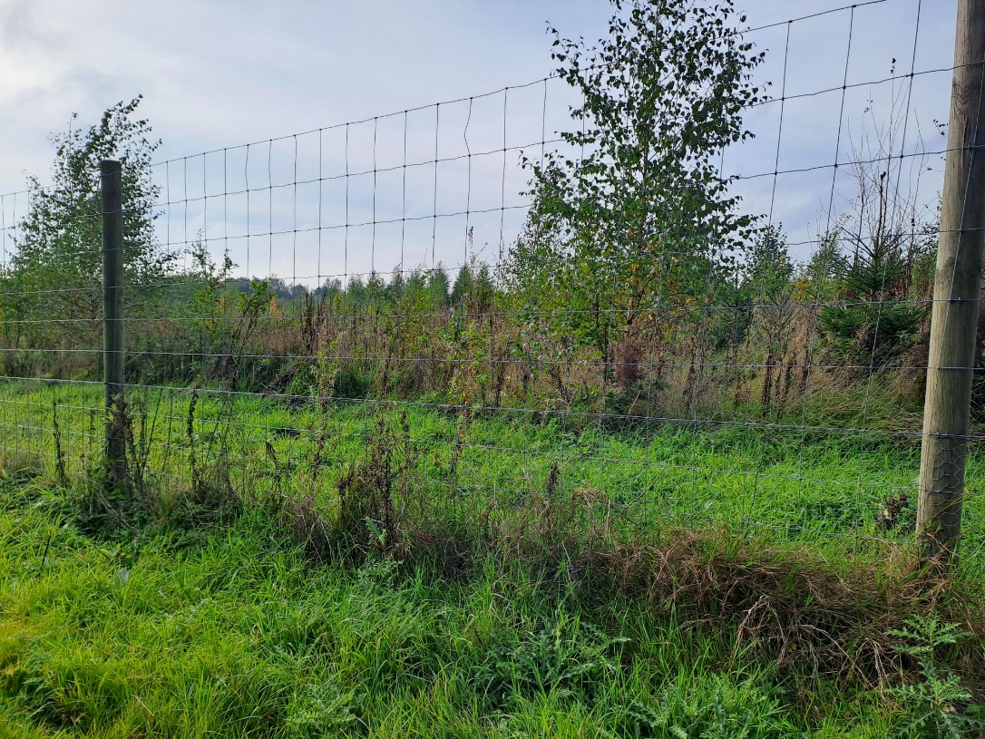
Rationale
High levels tree planting = changes to local landscapes & access to woodlands
Lack of understanding about how new planting / young woodlands impact local communities
How might this change over time?
Notes:
England has experienced high levels of tree planting as a result of the England Tree Action Plan. Changes to landscapes and access to treed areas. New planted areas contribute to a number of government policy objectives, including a target which aims to ensure that everyone in England should live within 15-minutes walk of a green or blue space.
Although there is a fair amount of evidence regarding the benefits of woodlands to people (much of it led by Liz O’Brien from Forest Research), there is very little on the benefits of new planting specifically or how new planting impacts local communities and how this might change over time as the trees grow and woodland forms.

Slide 3
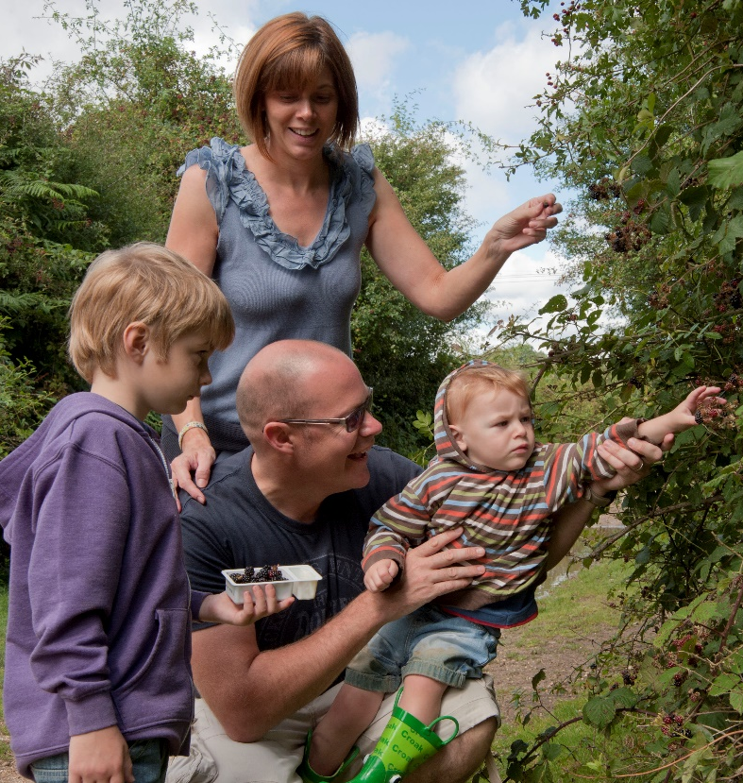
Objectives
Identify and develop connections with woodland sites and communities to study over time.
Explore attitudes, motivations, actions, barriers and benefits linked to new woodland creation and expansion (new planting) for diverse communities.
Develop and test a proof-of-concept for longitudinal research to study how attitudes, motivations, actions, barriers and benefits for communities local to new planting change over time.
Notes:
3. *proof-of-concept refers to establishing through testing whether such longitudinal research is feasible, what it would contribute, and how it could be achieved

Slide 4
Research Questions
RQ1 What do local community members who have visited the site think about the intervention (new planting and expansion of woodland) and how it has come about?
RQ2 What do local community members who have not visited the site (but are aware of the intervention) think about it and how it has come about?
RQ3 What impacts has the intervention had on local community members who visit/engage with the site?
RQ4 What impacts, if any, has the intervention had on local community members who have not visited (but are aware of the intervention)?
RQ5 How do we best capture the above change in attitudes, motivations, actions, barriers and benefits linked to woodland creation and expansion for diverse communities over time?
RQ6 What lessons can we take from the above to inform such interventions to help them improve provision of benefits and to maximise access/engagement with such sites and minimise negative impacts?
Notes:
Boils down to how local community members who have and have not visited the site think about it and whether they are impacted by it.
Plus, how would we capture this over time and what can we tell the people who design and manage these sites to help them optimise benefits

Slide 5
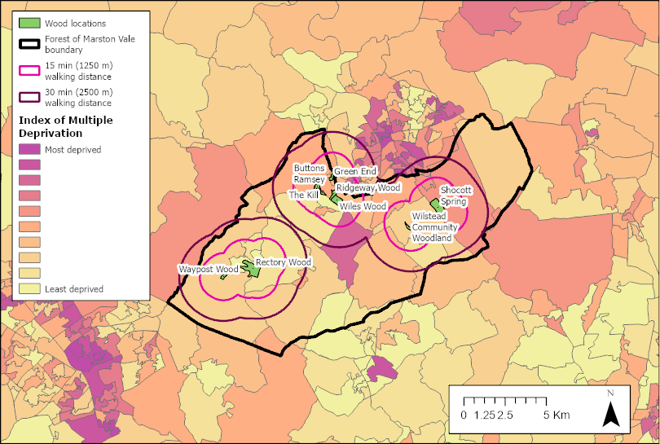

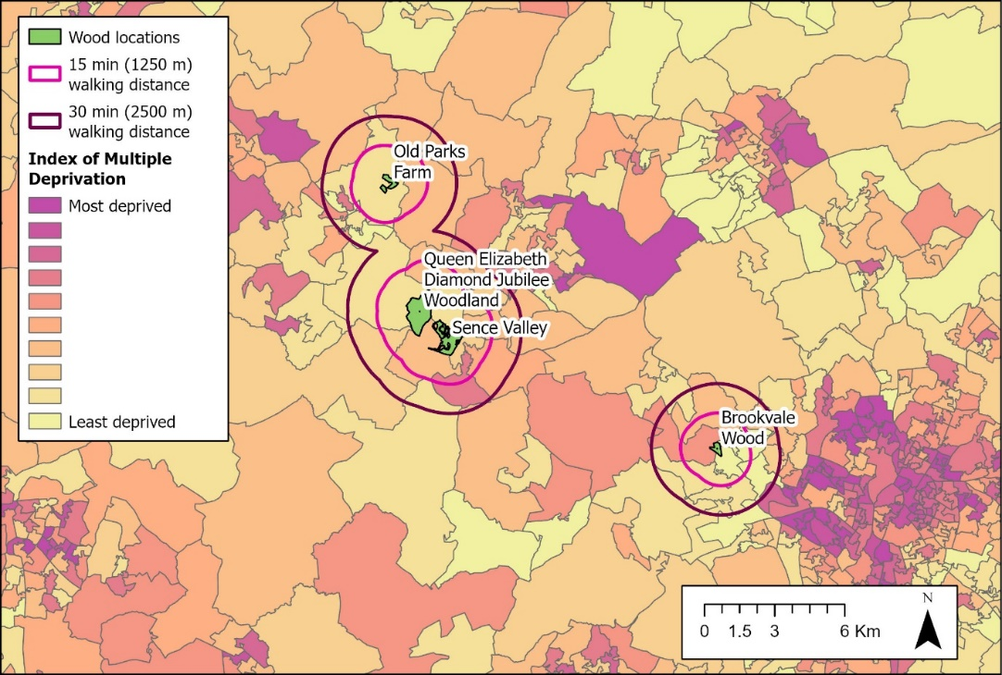
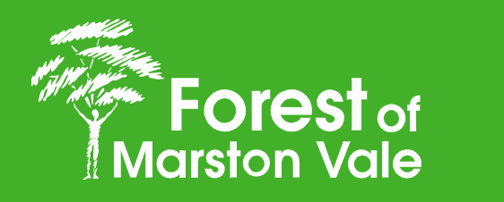
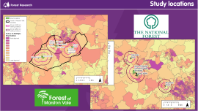
Study locations
Notes:
We have been working with the Forest of Marston Vale in Bedfordshire, which is a community forest. And the National Forest which covers parts of Derbyshire, Leicestershire, and Staffordshire. Both forests incorporate areas of industrial heritage as well as recent rapid building and infrastructure development. Both have ambitious tree planting plans. Want to thank them for their help.
We aimed to include contrasting communities as well as different ages of planting. Our planting age range covered up to 20 years to just planted. A key factor was that we wanted to focus on communities within walking distance of the planting – what we are calling hyper local communities - partly because these are mostly not ‘destination sites’ – they are often small in size and they are often explicitly meant for local communities to visit.

Slide 6
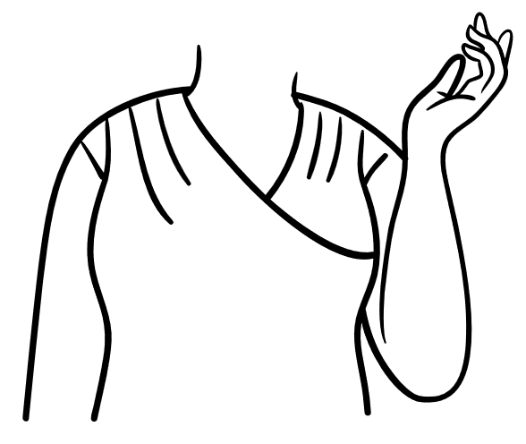



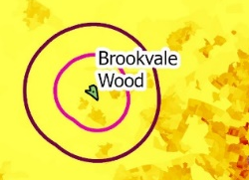



Methodological approach
Notes:
Important to understand how impacts on local communities may change over time – wanted to test a longitudinal approach – both with individuals and at a community level.
Reminder that longitudinal research is a type of observational and correlational research that involves monitoring individuals or a population over an extended period of time. It allows researchers to track changes and developments in the subjects over time and the effect of time on those individuals or populations and how they experience, in this case, new tree planting.
Only 2 years – so difficult to deliver longitudinal research – so for qualitative elements – innovated an intensive qualitative longitudinal approach – extending the lens of the research to consider participants’ life history, current experiences and also forward in time asking them to think about the future. Over 3 waves of interviews.
For quantitative element – we didn’t compare data between times points – but we did test and refine a potential approach to doing so, importantly, at a hyper-local scale – so focusing on the communities potentially most affected by the new planting.

Slide 7
Qualitative approach

Slide 8
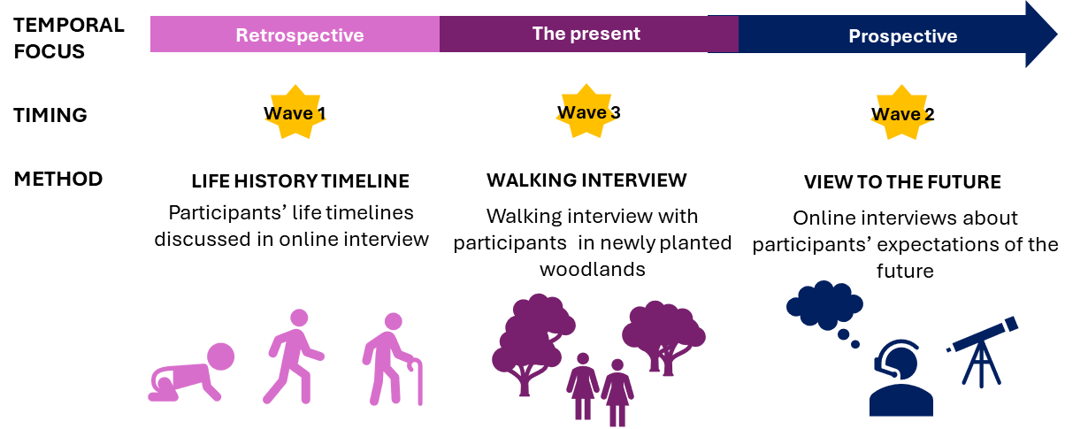
Qualitative approach
Notes:
Developed a unique methodology which utilised longitudinal approach. Point to separate methods report.
Wave order not chronological, due to logistical issues. But worked in this order.

Slide 9
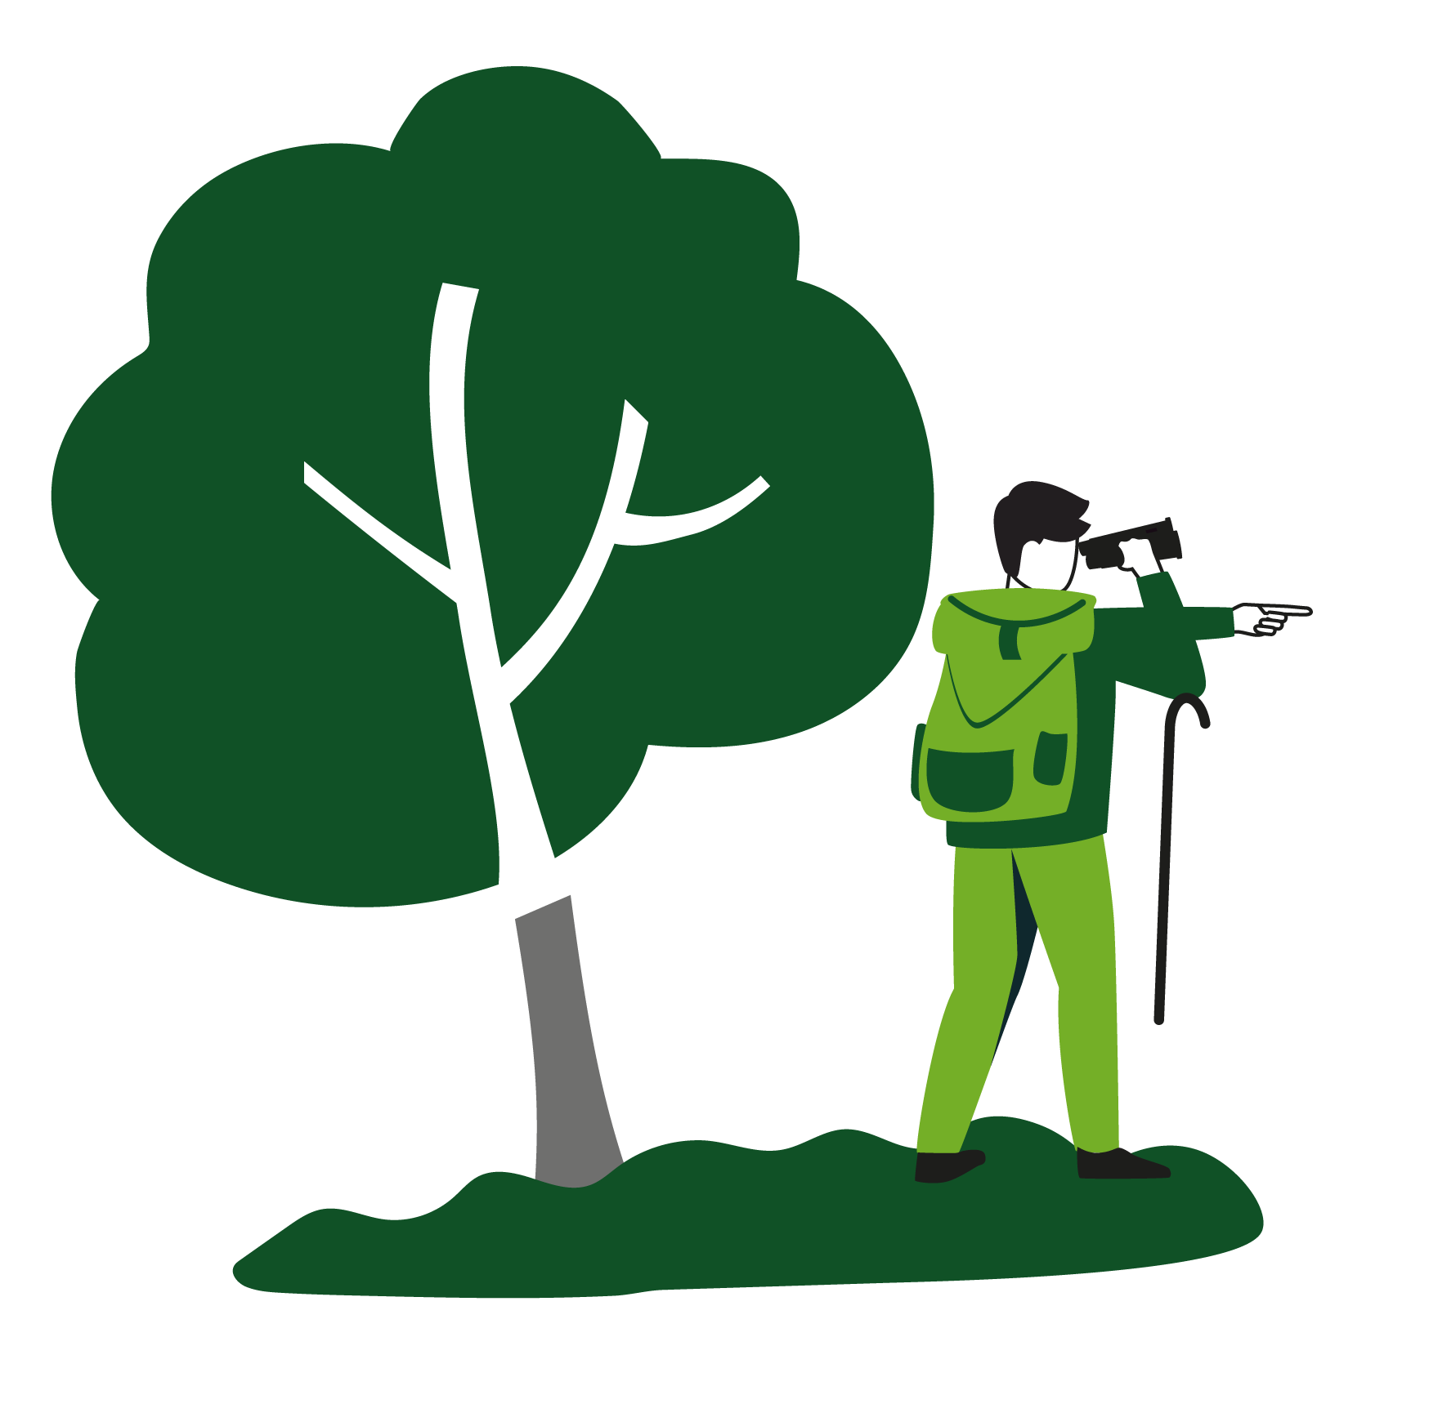

Qualitative approach
Themes
Experiencing change and sensing variety in new woodlands
Notes:
Key themes identified through analysis of qualitative data, But also want to point out we undertook a case biography approach to analysing the data as well. If you’d like more info on this please refer to the report, both the methods report and the full qualitative write-up appendix. The Storymap output on the webpage utilises the learning from this analysis.
But it is easier to explore the themes for this kind of presentation.
Experiencing change and sensing variety in new woodlands.
There were two main ways in which participants experienced new planting. First, as open, light and energetic places in contrast to darker, older woodlands which provide a sense of grounding and 'envelopment'. Secondly, the participants described benefiting from the unique experience of watching a new woodland being planted and growing. They enjoyed noticing changes within the woodlands over weeks, seasons and years. All their senses were used to experience and describe these changes.

Slide 10

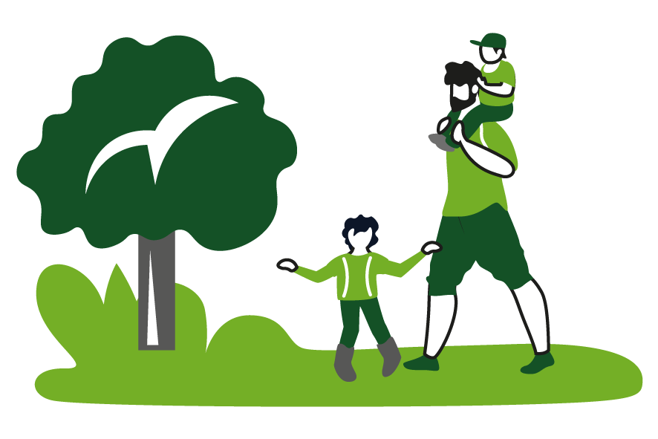
Qualitative approach
Themes
Stewardship of new planting
Notes:
Stewardship of new planting: Most participants expressed care for and a desire to protect the new woodlands. Noticing the trees growing and woodlands otherwise developing and changing contributed to these feelings, and some participants described themselves as ‘stewards’ or felt ownership in some way.
These feelings were particularly strong if they had participated in the planting of the trees or volunteered to undertake other woodland management activities
Feelings of stewardship appeared to be linked to factors such as the participants’ sense of place and belonging in these woodlands and the different values they placed on the woodlands, such as for socialising or inspiration.

Slide 11


Qualitative approach
Themes
Protection from development
New woodlands enable learning
Notes:
Protection from development: A number of participants in both case study areas were concerned about the rate of built development in their local area and expressed concerns over the lack of space for nature to expand locally. Newly planted woodland provided them with some reassurance that there is space for nature now and into the future, thereby conferring some form of protection from ‘over-development’ of their local area.
Opportunities for learning: Participants mentioned different aspects of learning or curiosity in relation to new woodlands. New woodland being distinct from older, established woodland in that they offer the opportunity to observe more rapid change. Noticing the appearance of new bird and plant species for example. Some participants explicitly linked this mental stimulation and sparking of curiosity to mental health benefits.

Slide 12
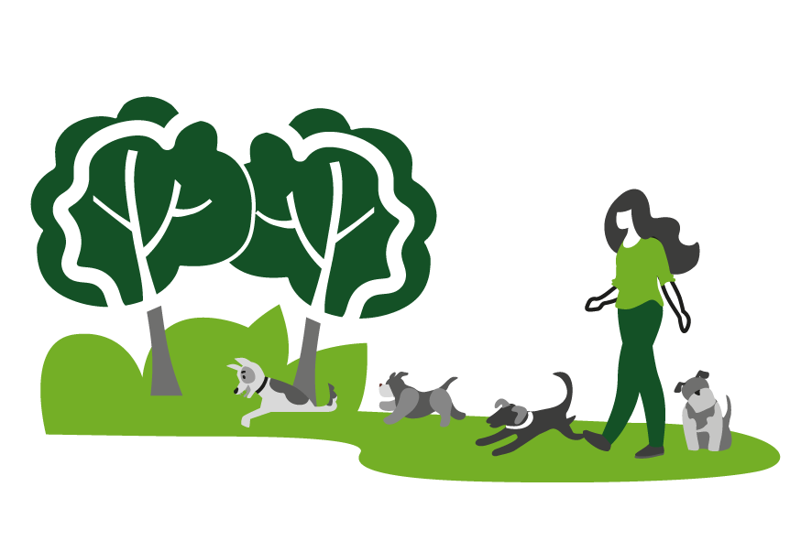
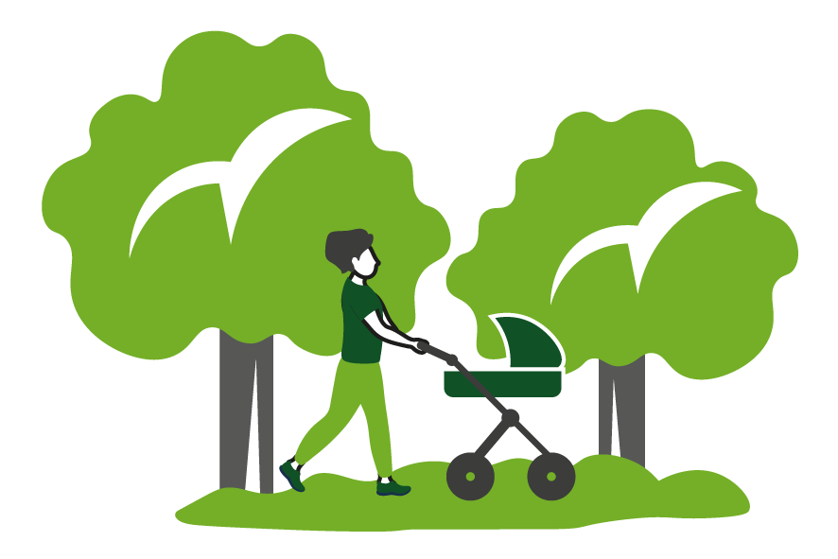
Qualitative approach
Themes
Sense of safety and protection
Finding hope and resilience in new woodlands
Notes:
We also identified themes relating to safety and protection and also finding hope and resilience – with participants mentioning feelings of hope, positivity and optimism from observing the young trees grow.
Sense of safety: Feelings of safety in woodlands was explored by a few participants, but from different viewpoints. Some participants worried about hurting themselves while visiting or the danger posed by others. There was some indication that the more open nature of the new woodlands can feel safer for some people.
Finding hope and resilience in new woodlands: Participants mentioned feelings of hope, positivity and optimism from observing the young trees grow. In particular, engaging in tree planting or other environmental behaviours in relation to the study site, provided participants with a sense of agency – an ability to do something about the state of nature and the climate.

Slide 13
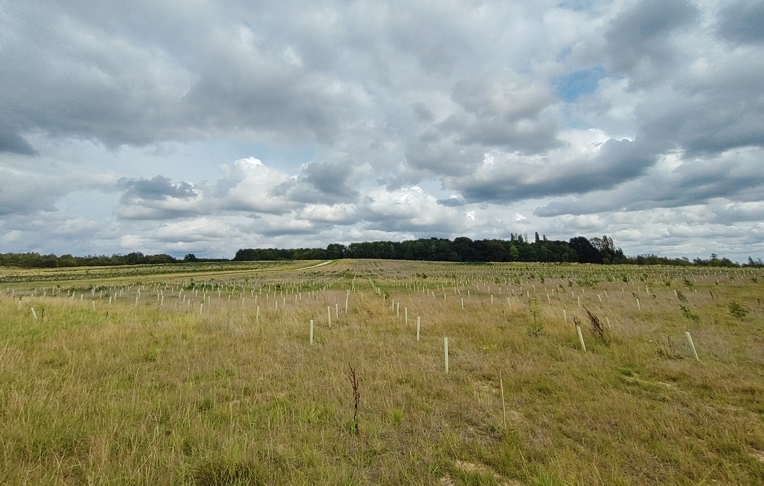
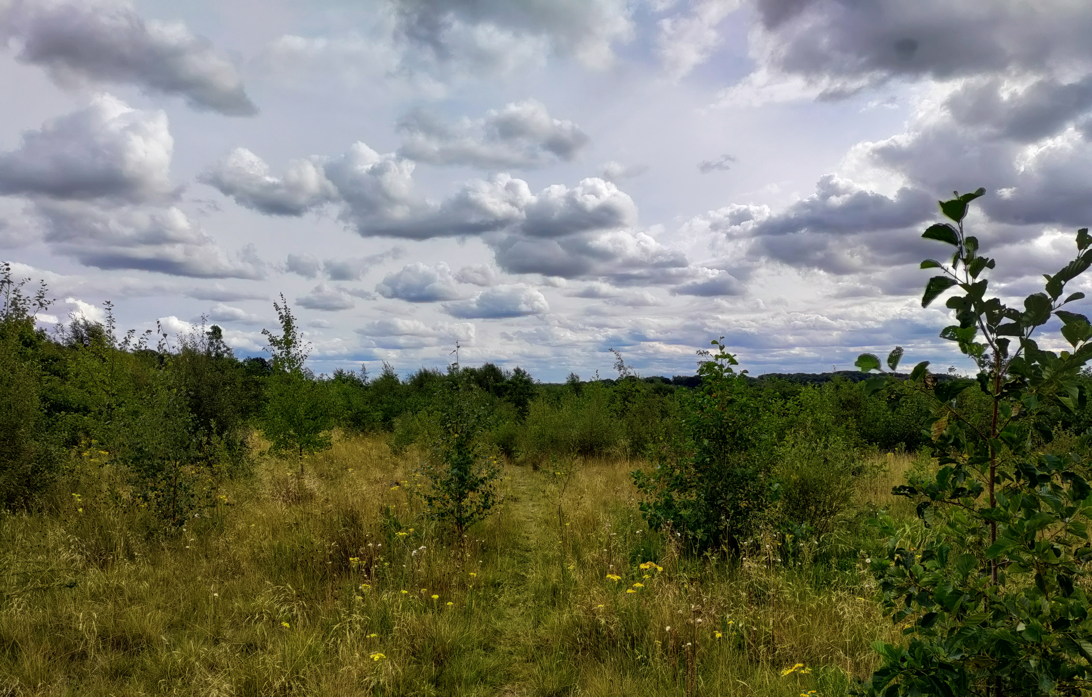
Qualitative approach
Unique wellbeing 'package' which can include ​
Physical activity​
Mental stimulation​
Opportunities for learning about nature
A cognitive break and time away from work​
Escape from hardships in life, a safe space​
Opportunities for reflection and healing
Building and maintaining a connection with nature
A sense of agency (stewardship)
Notes:
Each person has a unique combination of wellbeing benefits from these sites
Highly dependent on who they are as people and what they need nature to do for them

Slide 14
Qualitative approach
Sense of stewardship links back to other aspects of a person's life
Sense of place
Sense of belonging
Connection to nature
Feelings of ownership and responsibility
Altruistic concerns for others and for future generations
Self-determination
Their perceptions of 'naturalness'
Hyper-locality
Notes:
Self-determination relates to a person’s ability to grow and become what they perceive to be the best version of themselves. Three components contribute to this – autonomy, relatedness and competence (Ryan and Deci 2000; Cetas and Yasué 2017). Bennett et al. (2018) outline that “Autonomy refers to the desire to be able to affect one’s own future, relatedness is about feeling connected or belonging to a group, and competence refers to the feeling of being able to act and to achieve one’s goals”
This has been explored in depth in the report

Slide 15
Qualitative approach
New woodlands are unique
Evoke different emotions – light and energetic
The rate of change
Observing the growth of trees alongside one's own life – passing of time
Provide a sense of hope
Opportunity to act on environmental or local concerns through engagement e.g. tree planting
Hyper-locality matters
Notes:
Tend to assume new planting / young woodlands will provide the same benefits as existing woodlands, however we found they:
Evoke different emotions – for example as light and energetic
The rate of change can be positive, such as new species appearing, but can be negative, such as masking cherished views
Observing the growth of trees alongside one's own life – note passing of time
Provide a sense of hope
Opportunity to act on environmental or local concerns through engagement e.g. tree planting
Hyper-locality matters – often talked about in terms of ease of access, but also in terms of sense of place, sense of belonging and stewardship or sense of ownership and pride

Slide 16
Quantitative approach

Slide 17
Introduction to quantitative approach
Two Waves using a questionnaire at 4NF sites and 9FMV sites
  Wave 1 – February 2024. Used CATI and F2F (at Sence Valley only). Developmental.
  Wave 2 - November 2024. F2F only. [All results presented are from Wave 2]
  To be eligible the person had to have a home postcode within 2.5km of the named woodland site.
Questionnaire included 30 questions, primarily closed. Sections related to:
  Respondent perspectives on the newly planted trees,
  22 agreement statements about different aspects of the woodland,
  Details of site visits and activities & engagement with woodland activities besides recreational visits,
  Self-reported health and well-being questions,
  17 attitudinal statements about the social and cultural values of young woodland and newly planted trees in the local area,
  Socio-demographic information.
Notes:
Question routing depending on whether respondents had visited or not.

Slide 18
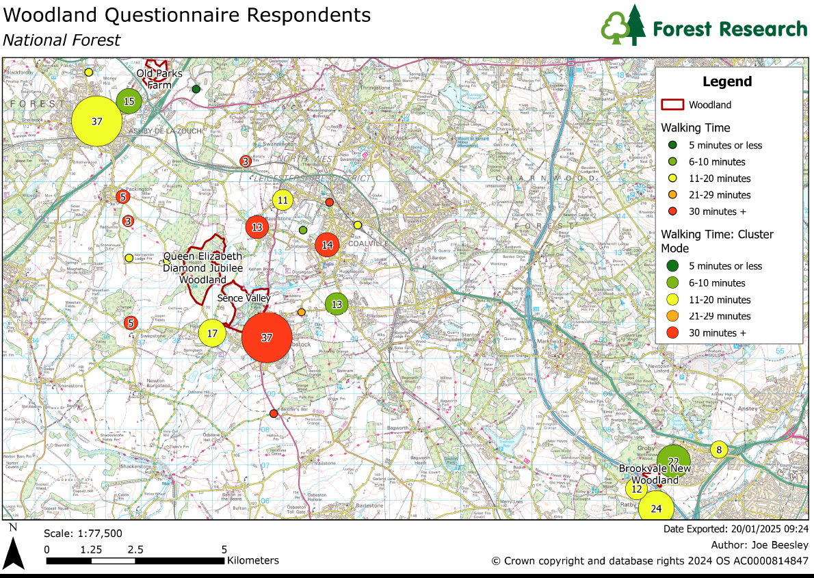
Respondents - location
 |  |  | Total | N (visitors) | N (non-visitors)
NATIONAL FOREST SITES |  | Brookvale New Woodland | 66 | 66 | 0
 |  | Queen Elizabeth Diamond Jubilee Woodland | 70 | 65 | 5
 |  | Sence Valley Park | 80 | 63 | 17
 |  | Old Parks Farm | 83 | 54 | 29
 |  | National Forest totals | 299 | 248 | 51
FOREST OF MARSTON VALE SITES | C1 | Rectory Wood | 55 | 55 | 0
 |  | Waypost Wood | 29 | 21 | 8
 | C2 | Wilstead Community Woodland | 51 | 48 | 3
 |  | Shocott Spring | 49 | 43 | 6
 | C3 | Ridgeway Wood | 17 | 13 | 4
 |  | The Kill | 30 | 24 | 6
 |  | Buttons Ramsey | 26 | 21 | 5
 |  | Green End Wood | 13 | 9 | 4
 |  | Wiles Wood | 20 | 17 | 3
 |  | Marston Vale totals | 290 | 251 | 39
 |  | Overall totals | 589 | 499 | 90
Notes:
Total 589 people surveyed – 299 NF and 290 FoMV. 499 visitors to one of the 13 woodland study sites across the 2 locations and 90 non-visitors. Was harder to find non visitors - interesting.

Slide 19
Respondents
Question | Category | N | Total | %
Age | 18-24 | 20 | 589 | 3.4
 | 25-34 | 39 | 589 | 6.6
 | 35-44 | 60 | 589 | 10.2
 | 45-54 | 90 | 589 | 15.3
 | 55-64 | 152 | 589 | 25.8
 | 65+ | 226 | 589 | 38.4
 | Prefer not to say | 2 | 589 | 0.3
Gender | Female | 305 | 589 | 51.8
 | Male | 280 | 589 | 47.5
 | Non-binary | 4 | 589 | 0.7
Ethnicity | White British / Irish / Welsh / Scottish | 519 | 589 | 88.1
 | Mixed or multiple ethnic groups | 16 | 589 | 2.7
 | Asian or Asian British | 41 | 589 | 7.0
 | Black, African, Caribbean, or Black British | 8 | 589 | 1.4
 | Any other ethnic group or background | 5 | 589 | 0.8
Employment status |  | N | Total | %
 | Student | 14 | 589 | 2.4
 | Unemployed | 5 | 589 | 0.8
 | Full time employed | 273 | 589 | 46.3
 | Part time employed | 43 | 589 | 7.3
 | Self employed | 32 | 589 | 5.4
 | Homemaker | 25 | 589 | 4.2
 | Retired | 190 | 589 | 32.3
 | Other | 3 | 589 | 0.5
Comparing the visitor and non-visitor samples:
Non-visitors - Lower percentage:
  of white respondents (-7%)
  of retired people (-8%)
  had lived in the area for more than 10 years (-20%)
  had access to a garden (-28%)
Approximately how long have you lived in the local area? | Prefer not to say | 2 | 589 | 0.3
 | 6 months or less | 12 | 589 | 2.0
 | More than 6 but less than 12 months | 25 | 589 | 4.2
 | 1 to 2 years | 26 | 589 | 4.4
 | More than 2 but less than 5 years | 107 | 589 | 18.2
 | 5 to 10 years | 99 | 589 | 16.8
 | More than 10 years | 318 | 589 | 54.0
Do you have access to a garden (private or shared) or an allotment? | Yes | 456 | 589 | 77.4
 | No | 133 | 589 | 22.6
Notes:
Did not set quotas due to hyper locality requirement, but fairly representative of England demographic make up

Slide 20
Respondents - Visitors
Visitors
499 completed visitor questionnaires
  248 National Forest sites;
  251 Forest of Marston Vale sites
47% visited the woodland several times per month
30% visited several times per week
64% of visitors stayed between 15-60 minutes
31% stayed for between 1-2 hours
98% of visitors thought the planting of trees at the sites was a good thing.
Notes:
47% visited the woodland several times per month
30% visited several times per week
64% of visitors stayed between 15-60 minutes
31% stayed for between 1-2 hours

Slide 21
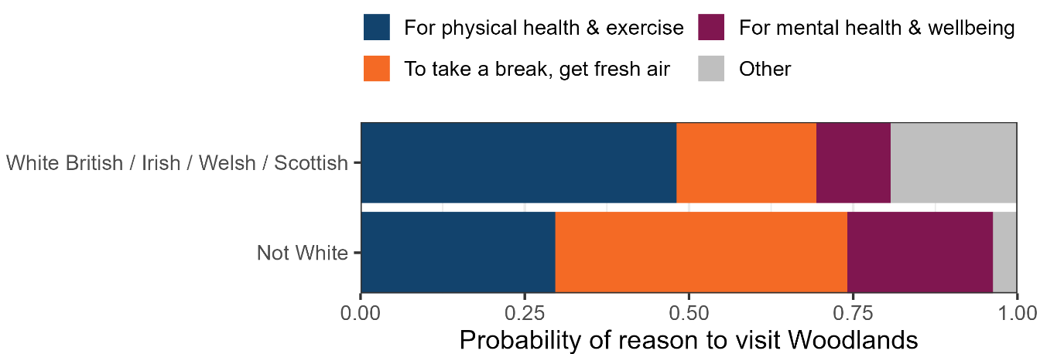
Respondents - location
Activity | N | %
Dog-walking | 210 | 42
Walking (without a dog) | 173 | 35
Running or jogging | 45 | 9
Wildlife watching | 19 | 4
Cycling | 14 | 3
Playing with children | 14 | 3
Picnicking / eating outside | 12 | 2
Climbing trees | 4 | 1
Woodland crafts | 3 | 1
Organised activity e.g. ranger event | 2 | 0.4
Other | 2 | 0.4
Notes:
The main activities that visitors undertook when they visited the woodlands were dog walking (42%) and walking without a dog (35%). Eighty two percent of visitors undertook their main activity about the same amount as before the new trees were planted, while 14% undertook the activity more often after the trees were planted and 4% less often.
Visitors were asked to indicate their main reason for visiting. The most frequent response was ‘for physical health and exercise’ (46%). Various factors influenced the main reason though and here you can see how the main reason for visiting varies by ethnicity broken down, due to sample size, into White and non-White respondents.

Slide 22
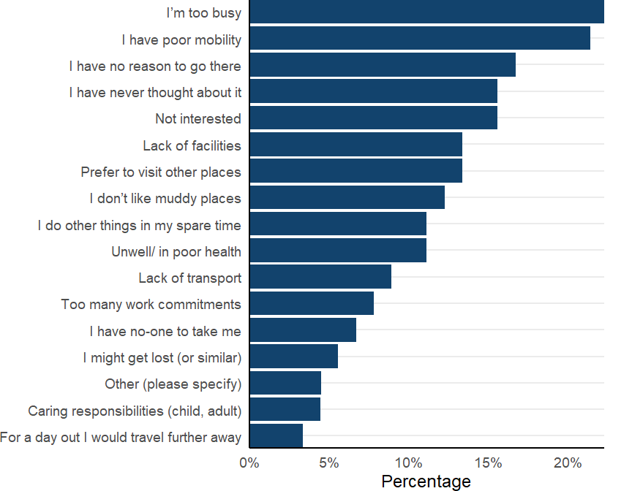
Respondents – Non-visitors
90 non-visitor respondents.
  51 National Forest/39 Forest of Marston Vale
Non-visitors were asked for their reasons for not visiting their local woodland.
  Most frequently mentioned: “I’m too busy” and “I have poor mobility”.
  Males & retirees more likely to say that poor mobility was the reason.
Notes:
Non visitors were asked about their reasons for not visiting

Slide 23
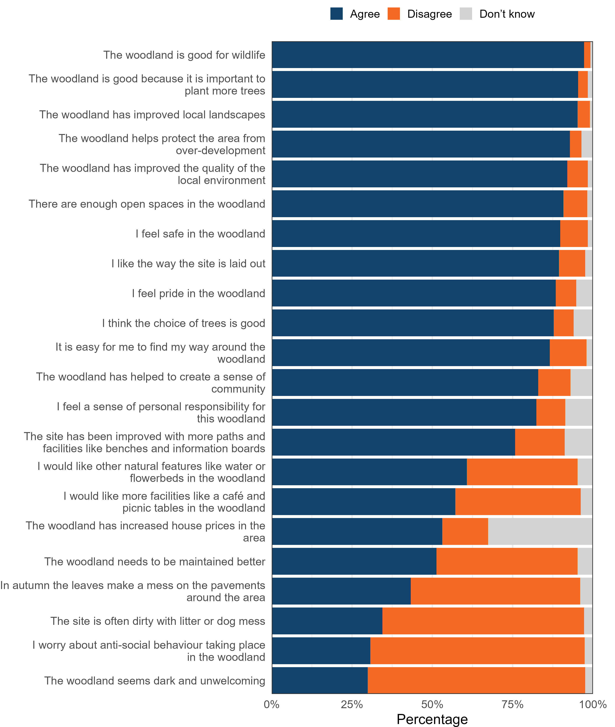
What do visitors & non-visitors think about the new planting?
Notes:
First of all - Visitors and non-visitors were positive about the new planting. 98% of visitors and 80% of non-visitors said they thought the new planting was a good thing.
Visitors were asked whether they agreed or disagreed with 22 statements about the woodland. Headline - Visitors are satisfied with the characteristics of the woodlands.
The figure shows visitor attitudes to new woodland sites (both study locations). It is the wrong shape for the slide – but this shows top part of it. With percentage agreement with each statement on the x axis.
Statements with the highest level of agreement included “the woodland is good for wildlife” (97%), “the woodland is good because it is important to plant more trees” (95%) and “the woodland has improved local landscapes” (95%).
There was some variation in agreement by visitor respondent type. There were some statistically significant differences in responses based on peoples’ socio-demographic characteristics. More details in report.
For example, those who had lived in the area the least amount of time were more likely to agree with negative statements such as “woodland seems dark and unwelcoming”, “in autumn the leaves make a mess on the pavements around the area” and “the site is often dirty”.
If time - Females were more likely to agree that they would like more facilities such as picnic tables and a café (compared to males). Females were also more likely to agree that they worry about anti-social behaviour in the woodland.
10 of the statements about the woodland were asked of non-visitors These 10 statements were selected as it would not have been necessary to visit the woodland to have an opinion (e.g. they could be answered based on knowing about them or seeing them from outside).
The two statements with the highest level of agreement (86%) were: ‘The woodland helps protect the area from overdevelopment’; and ‘The woodland is good because it is important to plant more trees’. New woodlands can support the development of pride in place, even for people who do not visit, as we found that 70% of non-visitors agreed with the statement “I feel pride in the woodland” (the equivalent result for visitors was 88%).
The two statements with the highest level of disagreement were both negative statements: ‘I worry about anti-social behaviour taking place in the woodland’ (54%) and ‘In autumn the leaves make a mess on the pavements around the area’ (34%).
Less frequent visitors to greenspace were more likely to agree that the leaves made a mess on the pavements, and more likely to worry about anti-social behaviour in the woodland.

Slide 24
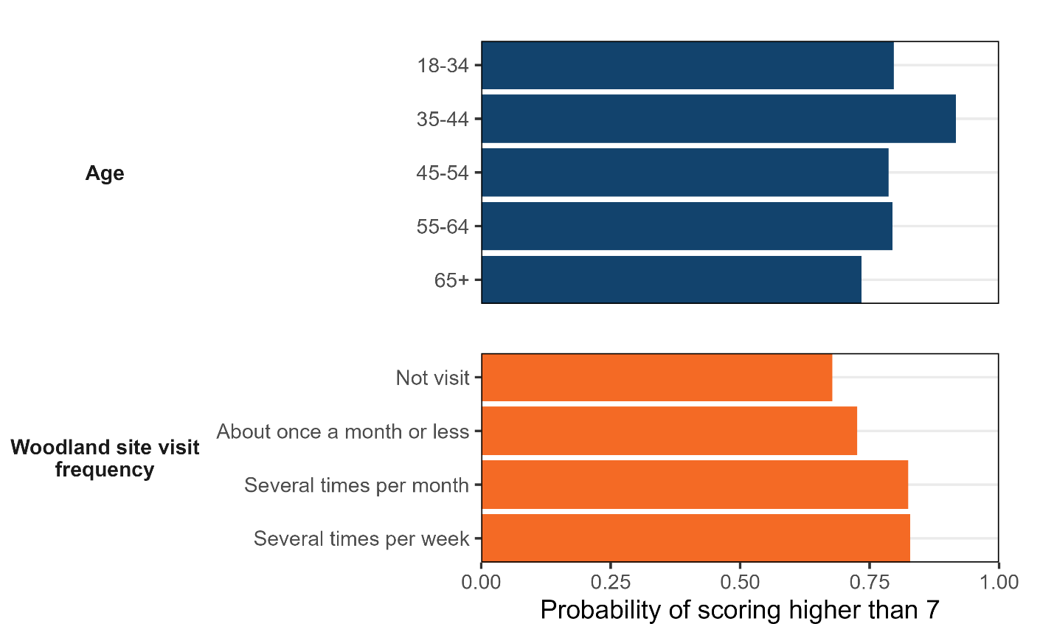
What benefits do the new woodlands confer?
Notes:
We also considered self-reported mental wellbeing and physical health against visit frequency and socio-demographics. On the screen you can see the results relating to mental wellbeing vs visit frequency. With higher scores indicating better self-reported mental wellbeing. The wellbeing questions were the standard ONS ones: Overall to what extent do you feel that the things you do in your life now are worthwhile? Overall how happy did you feel yesterday? Overall how satisfied are you with your life these days? Overall how anxious did you feel yesterday?
These were analysed to look for differences according to socio-demographic characteristics and visit frequency (including no visits)
Please see the report for the full picture. But headlines:
Those visiting the woodlands most frequently, experience better mental wellbeing (correlational). Visitors to the woodlands were more likely to report higher levels of happiness (on screen), life satisfaction, and believe that life is worthwhile. Respondents with the highest level of reported anxiety were those who never visit the woodland.
But there was no correlation between physical health and frequency of visiting the woodlands.

Slide 25
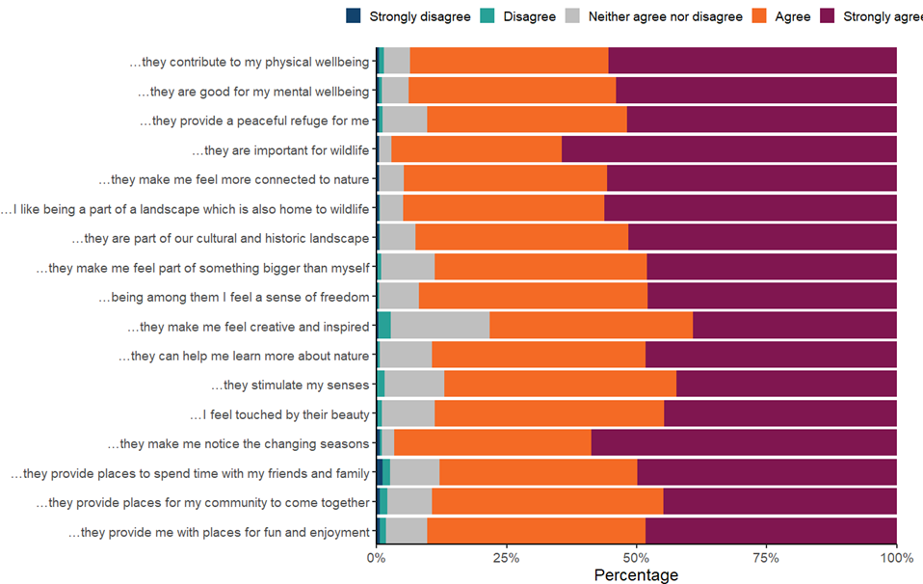
Social & cultural values wrt newly planted trees locally
“ I value young and newly planted trees in my local area because…”
Notes:
Respondents were asked for their level of agreement (5-point scale, strongly disagree to strongly agree) with 17 statements about the social and cultural value of new trees planted in their local area – any planting, not just the named woodlands. These statements are based on previous FR research which sought to ensure a full range of values were accounted for.
Each of the 17 statements began with the phrase: “I value young woodland and newly planted trees in my local area because…”.
This figure shows agreement levels across all 17 statements for all respondents.
Respondents who visit the woodlands most frequently are more likely to value new woodlands in general.
(Overall, for visitors and non, the strongest level of agreement was for the statements “they are important for wildlife” (64% strongly agree) and “they make me notice the changing seasons” (59% strongly agree).)
Responses to these statements were also analysed to investigate differences in whether new woodland is valued vs visitor frequency. With those who visited the woodlands more frequently being more positive about the value of new planting; this was significant for all bar four statements (“they make me feel creative and inspired”; “they provide places for my community to come together”; “they are important for wildlife”; “they can help me learn more about nature”).
Taken together with responses to the well-being questions, these results suggest a correlation between visiting woodland and respondent well-being and value experienced from new tree planting.
The next step would be to re-run the questionnaire at a future date and analyse for changes.
Comparing data collected in this study - about how much new local trees and woodlands are valued - and data from an all-England study (all local trees and woodlands), we found that all statements for this study were ranked statistically significantly higher than those in the England survey (all local trees and woodlands). Indicating that new local trees and woodlands may be more highly valued than established woodland, although more research would be needed to confirm this.

Slide 26
What do local communities think about the new woodland?
Creation of the new woodlands is a good thing
New woodlands can be associated with pride in place, even if you don’t visit them
Multiple things contribute to sense of stewardship
New woodlands can help create sense of community and feelings of protection from ‘over-development’
The more frequently people visit the woodlands the more they value them
Improvement to local landscapes
Notes:
So, combining our learning from both approaches to address the RQs in summary.
What do local communities think about the new woodland? Both visitors and non – RQs1 and 2
Overwhelmingly, these communities believe local tree planting and the creation of new woodlands is a good thing, whether they visit the sites or not. Interestingly, non-visitors shared many of the same positive attitudes about the new planting as visitors, (such as relating to contributions pride in place, suggesting that visiting new planting is not a pre-requisite to having opinions about or valuing these sites.) External viewing of new planting sites, vicarious experience and even just knowing about the sites can lead to formation of attitudes about them and valuing them.
Taking action to benefit the new woodlands can also build sense of personal responsibility or ‘stewardship’ towards the trees and the site more generally, as well as a sense of belonging. However, most visitors to new woodlands feel a sense of personal responsibility towards them, yet only a small proportion have been involved in on-site activities, which indicates that other attributes of new woodlands, such as opportunities to develop relationships with growing trees and observing change is likely to be contributing to building that sense of stewardship.
Many respondents, visitor and non-visitor, believe that the woodland sites help create a sense of community. With some participants valuing opportunities to develop new community links through visiting and through engaging with the new woodland creation and management.
From the qualitative data, we identified that some participants believed new woodland confers a degree of protection from ‘over-development’ of their local area, where it is felt to be encroaching on greenspace and nature. This was confirmed in the survey, with the majority of visitors and non-visitor respondents agreeing.
The more frequently people visit the woodlands the more they value them in a range of different ways. Local community members (visitors and non) particularly valued the benefits to wildlife from new woodlands. Our qualitative approach allowed us to explore this in more depth, for example we found people valued observing new species arriving onto a site and that they valued the new woodland providing space for nature to expand and species to disperse.
Survey respondents also particularly valued the perceived improvement to local landscapes. And we wondered if, given that both study locations are in post-industrial areas, it may be that this finding is particular to such landscapes, and local communities in areas with a different landscape history may not value this as strongly.

Slide 27
What impacts has the new woodland had?
People who visit their local new woodlands more frequently have better mental wellbeing
  Unique sensory experiences and learning opportunities
  Observing change at a faster rate
  Opportunities to develop connections to trees
Does new woodland encourage more active engagement than mature woodland?
Notes:
What impacts has the new woodland had on local communities? Both visitors and non – RQs 3 and 4
We found that new woodland can provide unique experiences and opportunities for visitors to benefit from exposure to them.
People who visit their local new woodlands more frequently have better mental wellbeing. These are correlational relationships, as with an observational study such as this one it is difficult to assign cause and effect. However, our finding indicates that there is a positive impact from increased exposure to these sites and we can consider the qualitative research findings to propose reasons for this, such as:
Unique sensory experiences and learning opportunities afforded by new woodlands, providing cognitive benefit and some restoration effects. For example, new woodlands can be experienced as energy-boosting and uplifting, in comparison to more mature woodlands.
Cognitive benefit from the ability to observe change at a faster rate in newly planted woodlands
Participants also highlighted the wellbeing benefits afforded through opportunities to develop relationships or connections with growing trees in general and with specific trees. With experience of tree planting and other volunteering activities helping participants build meaningful memories.

Slide 28

Methodological learning & informing interventions
Notes:
For RQ5 - How can we best capture perceptions of new woodlands and impacts for local communities over time?
See full methods report, but key messages:
Beneficial to consider at an individual level and at a community level
It is challenging but important to consider hyper-locality – where woodlands are community woodlands, rather than destination sites
Have developed an approach for setting up a longitudinal study

Slide 29
Learning for new woodland sites
People enjoy variety in woodland, maximise opportunities for visitors to notice this variety, especially re different sensory experiences.
Many participants expressed an appreciation for a ‘natural look and feel’ but perceptions of naturalness vary.
People may react strongly to management which disrupts their connection to a woodland, especially woodland they have seen grow from new planting.
There are a variety of motivations for visiting new woodlands and that different people want different things from places (e.g. isolation vs facilities).
Notes:
And finally, what lessons can we take from this to inform such interventions to help improve provision of benefits and to maximise access/engagement? RQ6
People enjoy variety in woodland, so site designers and managers should maximise opportunities for visitors to notice this variety, especially where this enables them the opportunity for different sensory experiences. In addition, young woodlands can provide more opportunity for visitors to notice variety through change (spatially and temporally) and this can be maximised through design and management.
Many participants expressed an appreciation for a ‘natural look and feel’ but perceptions of naturalness vary. By considering these different perceptions of ‘naturalness’ and testing them out with visitors and potential visitors, sites can cater for different natural aesthetics.
People may react strongly to management which disrupts their connection to a woodland, especially woodland they have seen grow from new planting. By informing the public about why particular management choices have been made, for example, selection of new tree species (use of non-natives), planting approach (e.g. rows or dense compartments) and thinning, site managers can help to avoid adverse reactions.
This research highlights the variety of motivations people have for visiting new woodlands and that different people want different things from places (e.g. isolation vs facilities). Explicit consideration of the range of these motivations and preferences can help ensure a diversity of visitors.

Slide 30
Learning for new woodland sites cont.
Engaging people in designing and creating woodlands, through volunteering and outreach, can support protective behaviours and how much the woodland is valued.
Many people care about providing space for wildlife, emphasizing such provision in site design and in communication by site managers will improve how much the community values the site.
Non-visitors will likely have an opinion about woodland sites too and should be consulted about sites where possible.
Newer arrivals to an area are more concerned about negative attributes.
Design open spaces into woodlands to improve perceptions of safety
Notes:
Engaging people in designing and creating woodlands, through volunteering and outreach, can support protective behaviours and how much the woodland is valued.
Many people care about providing space for wildlife, emphasizing such provision in site design and in communication by site managers will improve how much the community values the site.
Non-visitors will likely have an opinion about woodland sites too and should be consulted about sites where possible.
We found that newer arrivals to an area are more concerned about negative attributes (dog poo, darkness, leaves leaving a mess) and improved familiarity with a site appears to reduce these concerns. Anything site managers can do to encourage more visitors to use a site, especially new arrivals, will therefore improve overall community perceptions.
Design open spaces into woodlands to improve perceptions of safety. Female visitors express stronger fears around anti-social behaviour on sites compared to males. Non-visitors were more concerned about antisocial behaviour on site than visitors, so it may be that events to introduce people to the sites, tailored to nonvisitors, may lead to decreased community concern as site familiarity increases.

Slide 31
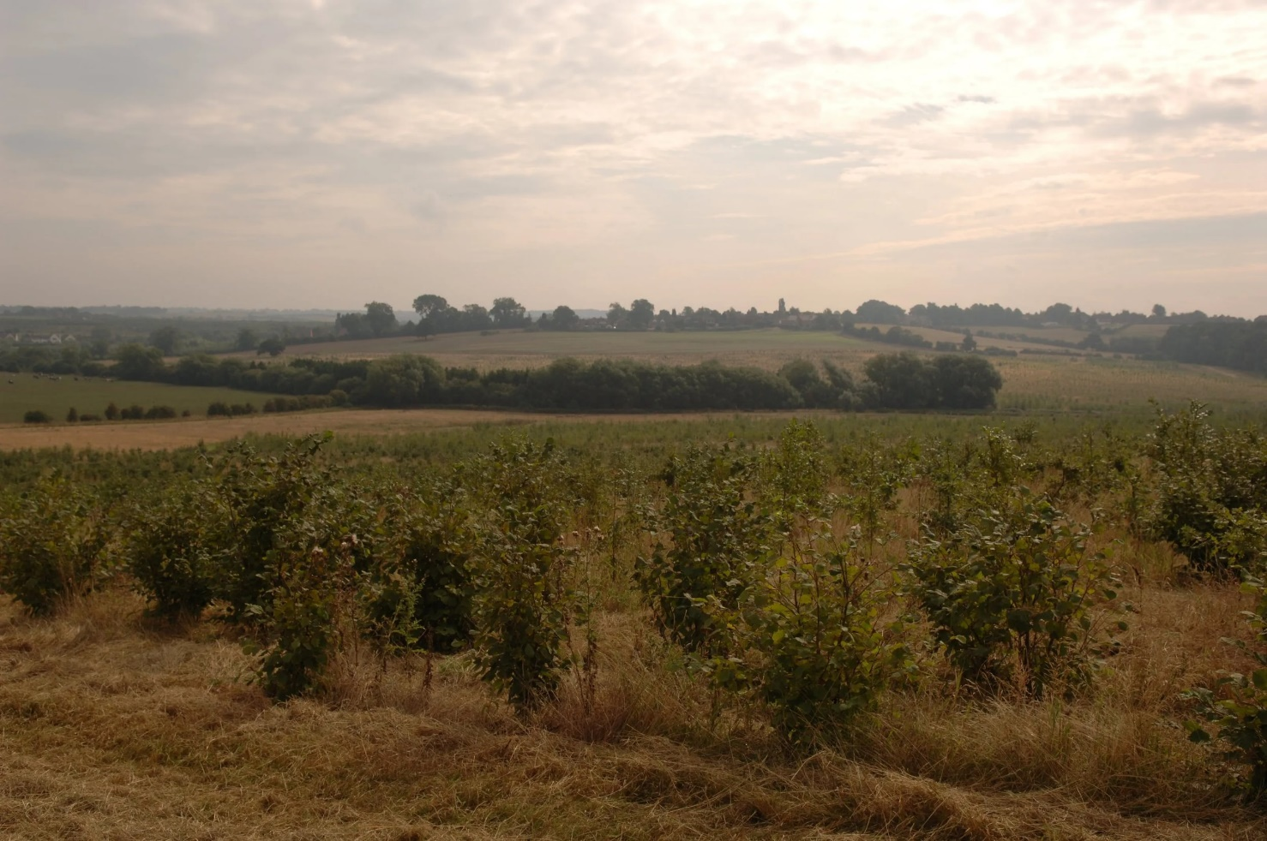
Reporting available
beth.brockett@forestresearch.gov.uk
https://www.forestresearch.gov.uk/research/mapping-the-social-benefits-of-woodland-creation-and-expansion/
Notes:
View over new planting at Sence Valley, NF, taken by Elliot Colley

